Slide 1
Basic Probability and Statistics
SHALA-2020
https://shala2020.github.io/

Slide 2
Learning Objectives
Match PDF and PMF to outcomes of random experiments
Write the relationship between PDF and CDF
List common distributions and their parameters, means, and variances
Write the condition for statistical independence of two variables
Write the equation for the likelihood of a parametric distribution
Write the steps for hypothesis testing

Slide 3

Random variables - discrete and continuous
Say, we have an experiment with a random outcome (e.g. coin toss)
We can map the set of outcomes to a variable that takes a unique value for each outcome (e.g. {0,1} for heads and tails)
The value can change each time the experiment is conducted
Such a variable is a random variable
Random does not mean that all outcomes are equi-probable
A biased coin can give more heads than tails, so somewhat predictable
But, we still cannot predict each outcome with certainty
Some random variables take continuous values
E.g. Height of the next person you will see on the road
Height measured in meters is a random variable
It still is random yet somewhat predictable; you won’t see someone less than 1 foot, or more than 8 feet
T
H

Slide 4
Probability of a random variable taking a value
Each outcome of an experiment is associated with a probability
It is the expected proportion of the times you will see that outcome
E.g. for a fair coin, prob(heads) = 0.5; or rather p(X=0) = 0.5
For a biased coin, prob(heads) may be 0.53; prob(tails) = 0.47
For a continuous variable, prob(X=x) = 0; prob(height = 1.6m exactly) is zero
But, probability of an interval is finite; e.g. prob(1m < height ≤ 2.5m) = 0.66

Slide 5
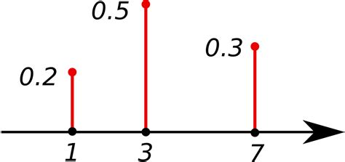
Probability mass function (PMF) of discrete variables
PMF maps discrete values of an RV to probabilities
The probabilities sum up to 1
E.g.
p(X=1) = 0.2,
p(X=3) = 0.5,
p(X=7) = 0.3,
p(X ≠ 1 and X ≠ 3 and X ≠ 7) = 0
Image and example source: Wikipedia

Slide 6
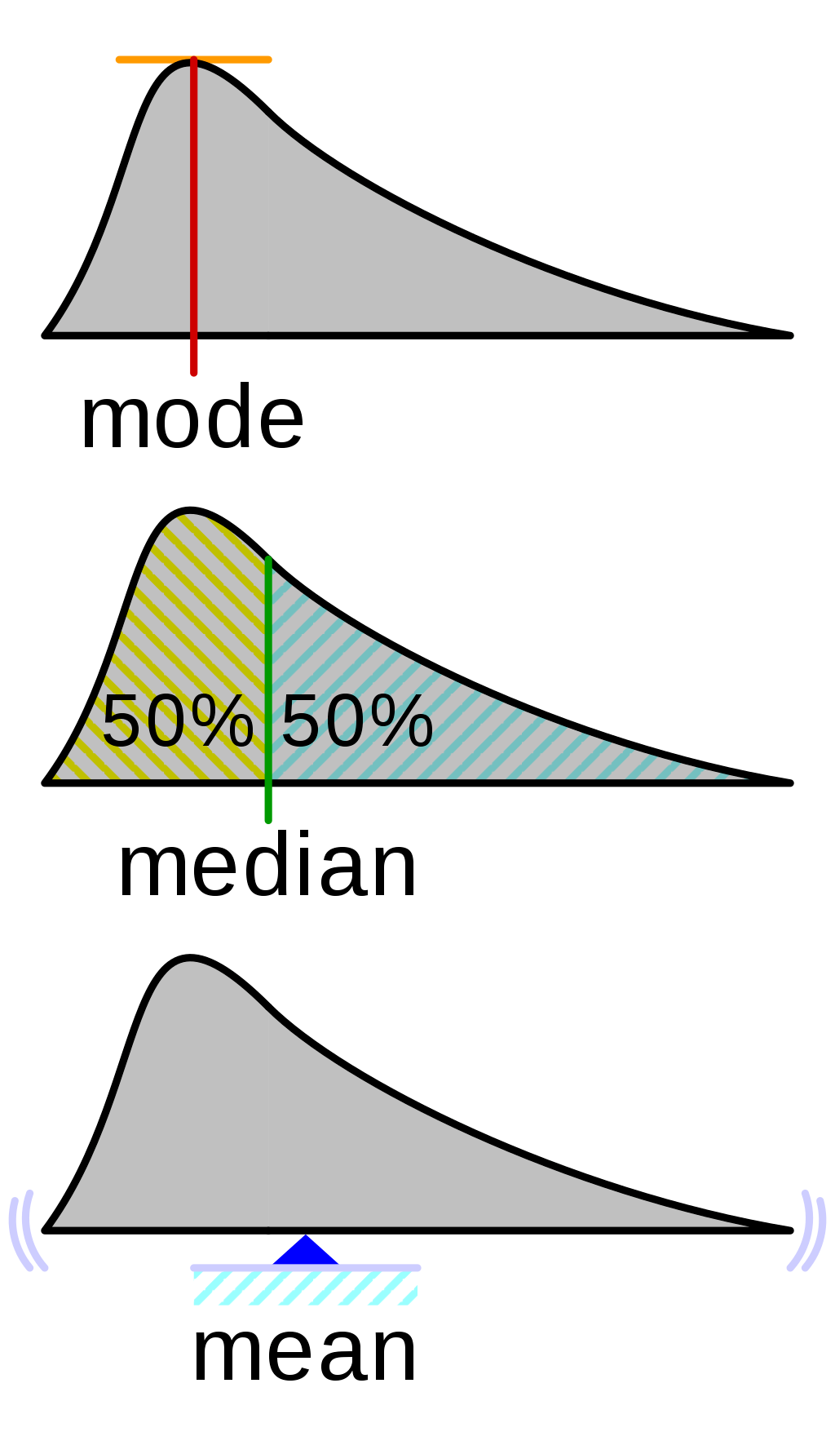
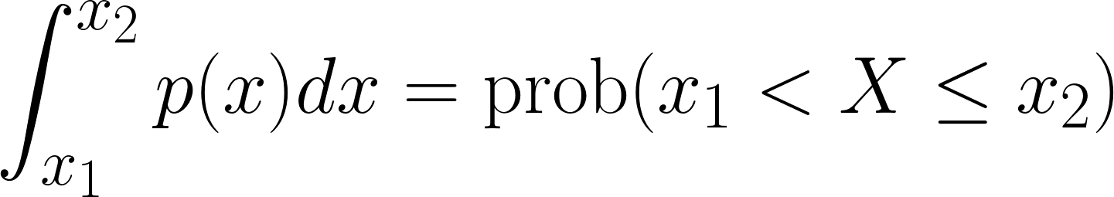

Probability density function (PDF) of continuous variables
Since a prob(X=x) = 0 for a continuous RV, we define a function for intervals
p(x) is a function such that:
Warning: Do not try to interpret the PDF at a single point!
Always interpret it in relation to other points
p(x)
Image source: Wikipedia
x

Slide 7
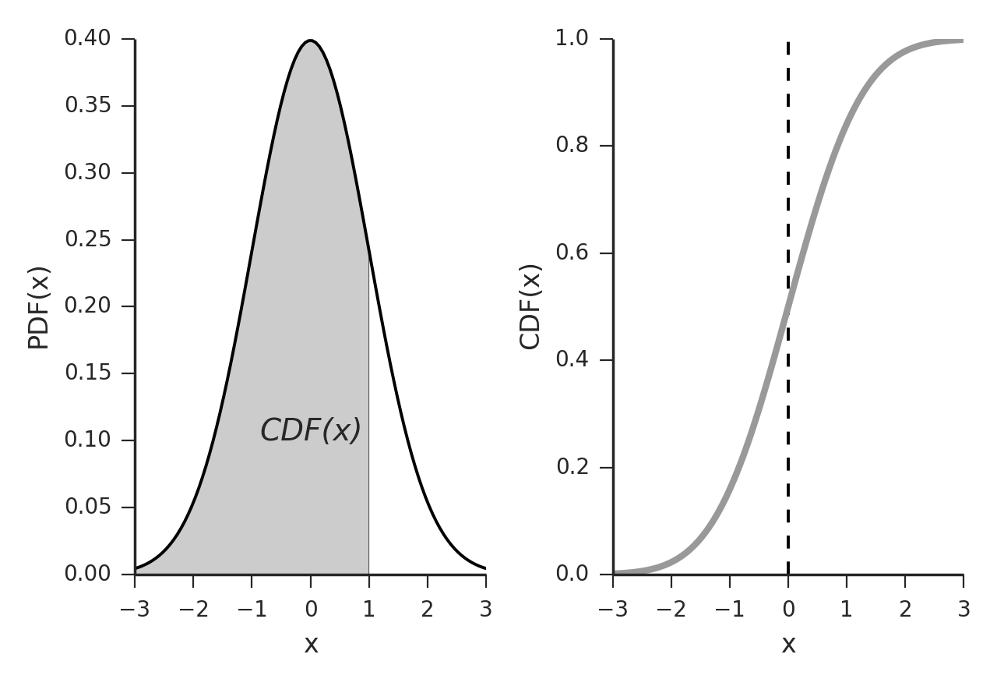

Cumulative distribution function (CDF) of continuous variables
CDF represents cumulative density
Image source: deepai.org

Slide 8
Cumulative distribution function (CDF) of discrete RVs
Consider the following event of a football match with the set of outcomes :
S = {Win,Draw,Lose} and P(Win) = 0.7 , P(Draw) = 0.2 , P(Lose) = 0.1
Let the random variable X capture the points obtained in that match :
X = { 0 : Lose, 1 : Draw, 3 : Win}
Can you plot the distribution function for X?
(CDF(X=x) as a function of x?)

Slide 9
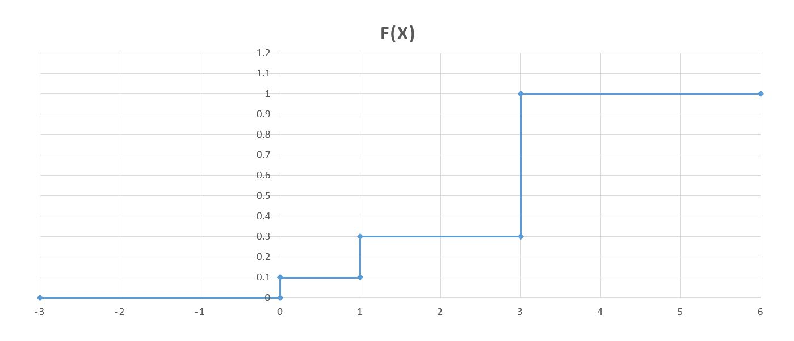
Cumulative Distribution Function

Slide 10
CDF properties
0 ≤ CDF(x) ≤ 1 : CDF(X) is a probability value
CDF(x) is non-decreasing : prob(X ≤ x1) ≤ prob(X ≤ x1+x2) for x2≥0
CDF(-∞) = 0 , CDF(+ ∞) = 1

Slide 11
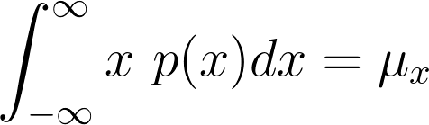
Mean is expected value of a random variable
Center of mass of the PDF
p(x)
Image source: Wikipedia
x

Slide 12
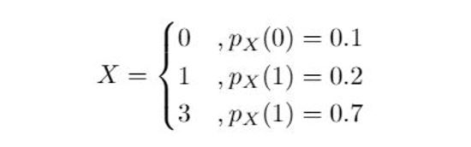
Expected Value of the RV
Consider the example for the RV capturing points obtained after a football match. We had:
Then E[X] = 0*0.1+1*0.2+3*0.7 = 2.3

Slide 13
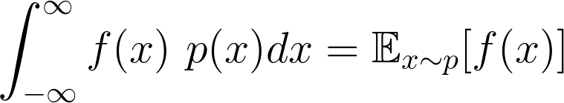
Expected value of a function of an RV
Expected value of any function of f(x) of x

Slide 14
Expected value of a function of an RV
For the previous example of a football match points :
If Y = X³
E[Y] = 0*0.1 + 1*0.2 + 27*0.7 = 19.1

Slide 15
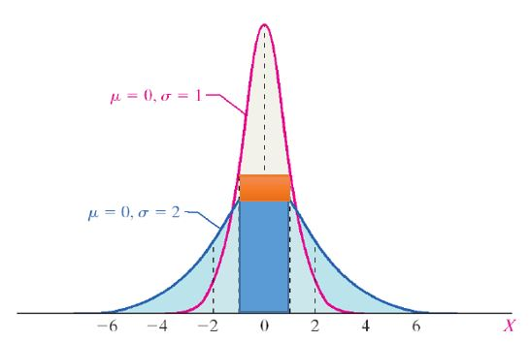
Variance as a measure of dispersion
Two RVs with the same mean can have very different distributions. Consider the pdfs of two RVs shown below :
Both are Gaussian distributions with the same mean. But the probability of them being in [-1,1] is very different with the red curve having larger area under the curve (the orange rectangle is the difference between areas). This corresponds to lesser variance of the pink curve
Image source : lumenlearning.com

Slide 16


Variance of a random variable
Variance is the second central moment of an RV
Similarly, we can define the n^{th} central moment (3 is skew, 4 is kurtosis)

Slide 17
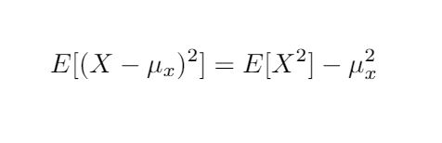
Variance of a random variable
A well known form of variance is
So we can calculate the variance for the football match example as:
E[X²] = 0*0.1 + 1*0.2 + 9*0.7 = 6.5 ; (E[X])² = (2.3)² = 5.29
var(X) = 6.5 - 5.29 = 1.21

Slide 18
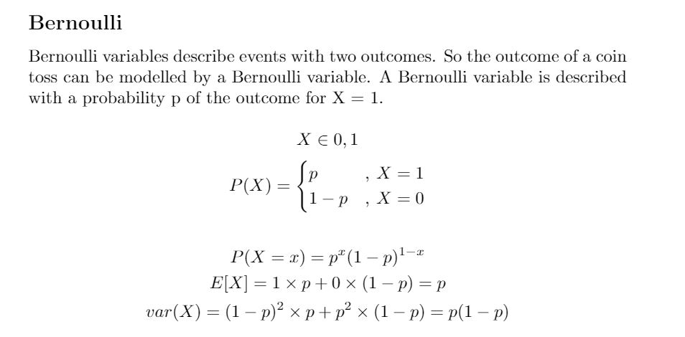

Slide 19
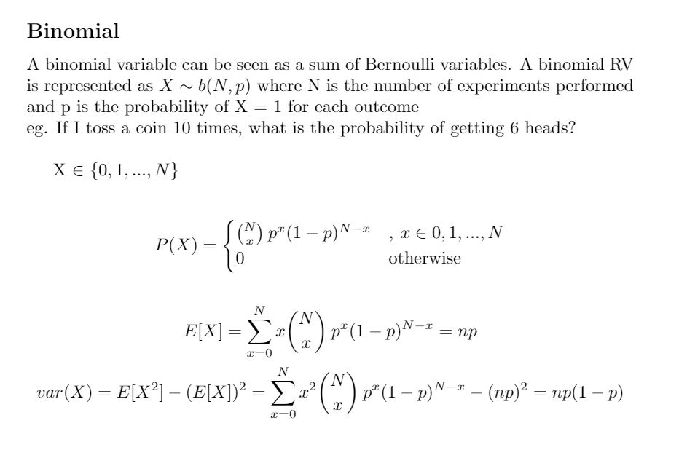

Slide 20
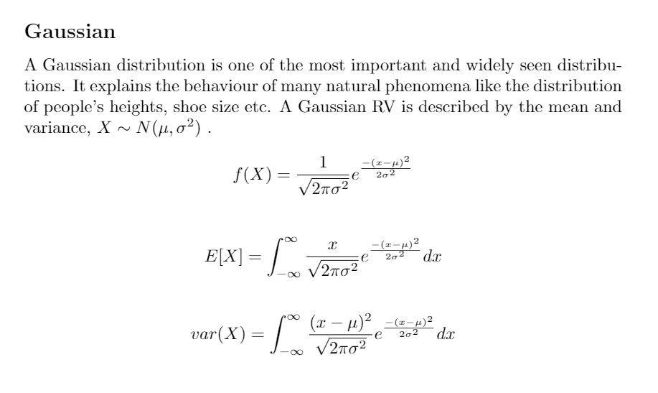

Slide 21
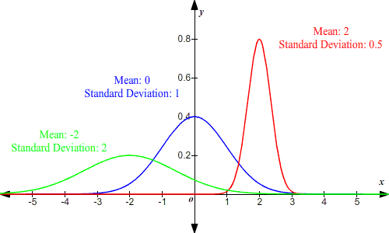
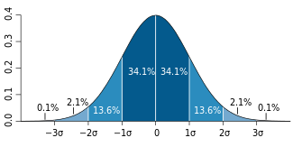
Gaussian distribution
Image source : Wikipedia
Image source : varsitytutors.com

Slide 22
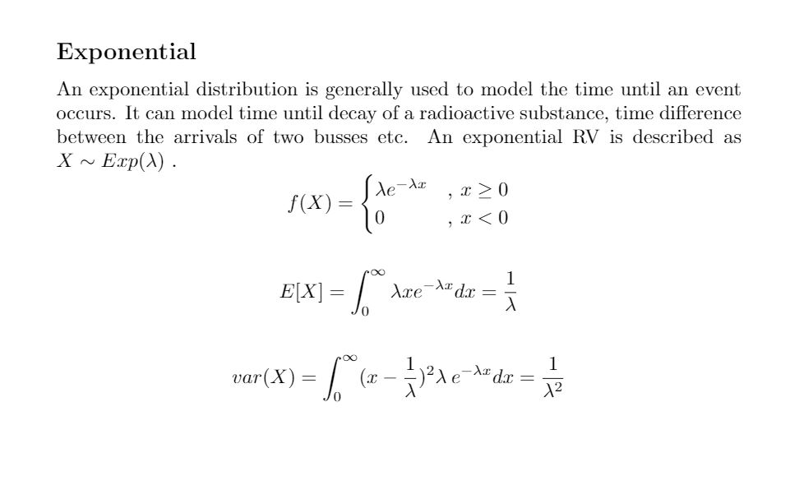

Slide 23
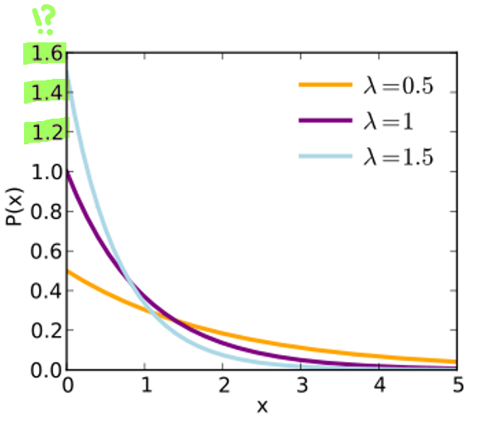
Exponential distribution
Image source : towardsdatascience.com

Slide 24
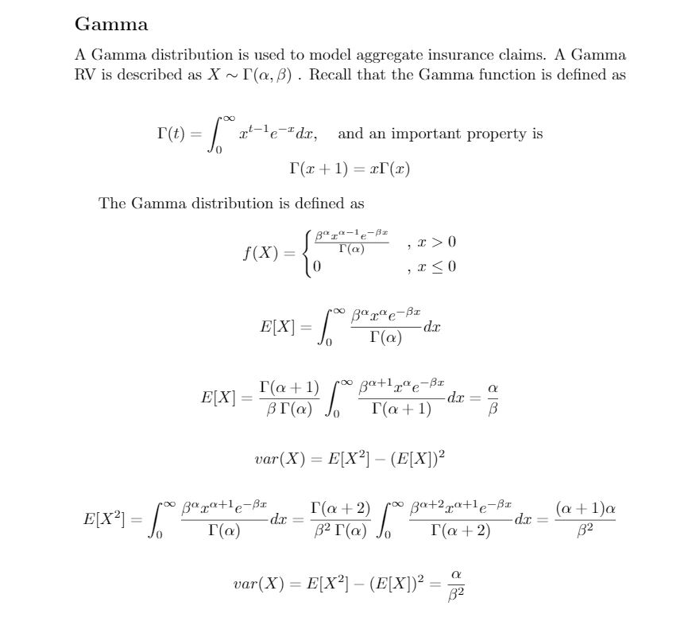

Slide 25
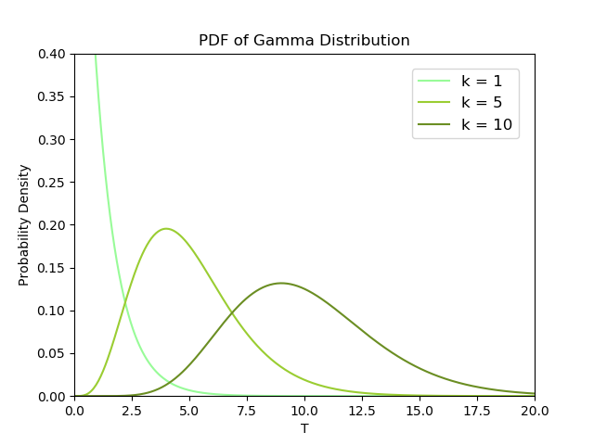
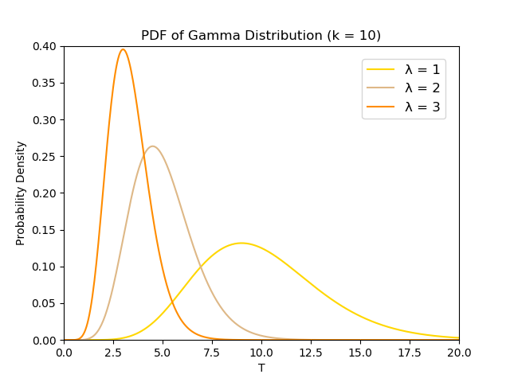
Gamma distributions
k is alpha lambda is beta
image source : towardsdatascience.com

Slide 26
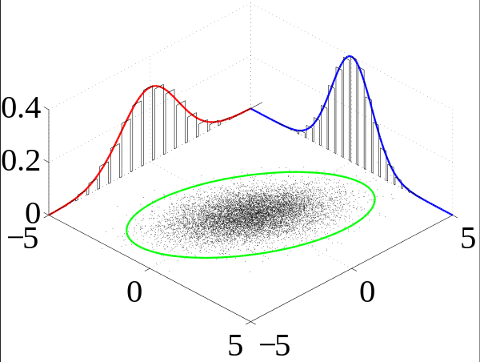

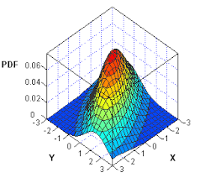
Multiple random variables and joint distribution
Let there be two variables x and y
The joint distribution is a surface parameterized by two variables p(x,y)
Image sources: sas.com, Wikipedia

Slide 27

Marginal probability eliminates one variable
If we eliminate y, then we get a one-dim function p(x),
That is the marginal density function; a projection of the 2-d function onto 1-d
Image sources: sas.com, Wikipedia

Slide 28

Conditional probability assumes a fixed value for some variables
If we fix y = Y, then we get a one-dim function p(x | y=Y )
It is a normalized slice of the 2-dim function for y=Y
Image sources: sas.com, Wikipedia

Slide 29
Statistical independence of two random variables
Two variables x and y are independent if and only if:
p(x,y) = p(x) p(y), for all values of x and y
Else, for dependent variables:
p(x,y) ≠ p(x) p(y) at least not for all values of x and y

Slide 30
Independently identically distributed (I.I.D.) sample
Treat each sample drawn as a random variable
Each such random variable is identically distributed
Each random variable is also independent of each other
E.g., heights of two people sampled at random at a metro station is independent of each other
And, they are likely to have the same distribution

Slide 31
Likelihood of single instance of an RV
If we assume a distribution p_{𝜃}(x) parameterized by 𝜃
Then, if we observe a single instance labeled x₁, then its distribution is: p_{𝜃}(x₁)
Then, the likelihood of x₁ taking value X₁ is p_{𝜃}(X₁)

Slide 32
Likelihood of an I.I.D. sample
For an IID sample of x₁,x₂, ... , x_{n}
The likelihood is going to be a product of all these (because of independence)
That is the likelihood of parameter 𝜃 given observations X₁,X₂, ... , X_{n} is
p_{𝜃}(X₁) p_{𝜃}(X₂) … p_{𝜃}(X_{n}) = ∏_{i=1 to n} p_{𝜃}(X_{i})
Log likelihood of 𝜃 is ∑_{i=1 to n} log p_{𝜃}(X_{i})

Slide 33
Comparing likelihood of two distributions
Between two parameters 𝜃₁ and 𝜃₂ the one with higher log likelihood better explains the data
This is the basis of statistical tests
Image source : varsitytutors.com

Slide 34
Maximum likelihood as an optimization problem
One can form an optimization problem to maximize the likelihood by defining a likelihood function in terms of a continuous variable 𝜃 and setting its derivative with respect to 𝜃 to zero
This is the basis of some ML techniques

Slide 35
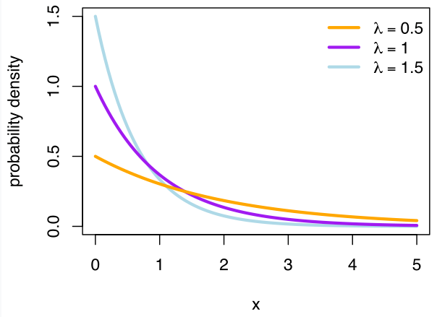
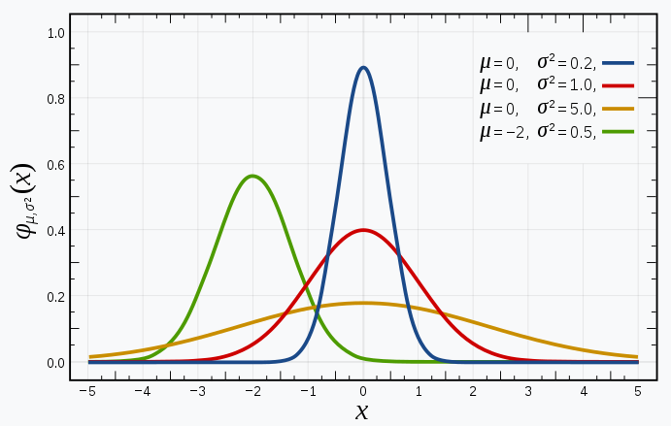
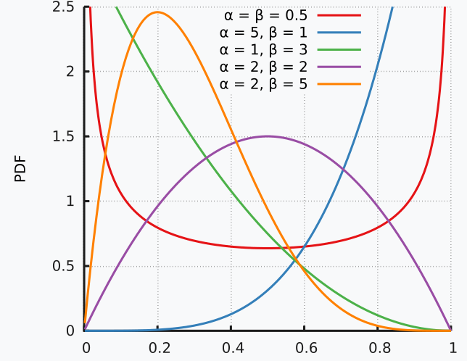
Sufficient statistics
For some distributions, estimating certain finite number of sample statistics is sufficient for maximizing the likelihood
E.g. mean for an exponential distribution
E.g. mean and variance for a Gaussian
Generalized to “location” and “dispersion” parameter for several distributions of “fixed shape” that can be translated and stretched
Some function families do not have a fixed shape, e.g. beta, and need more number of statistics to reach sufficiency; others may never reach sufficiency
Images source: Wikipedia

Slide 36
Hypothesis testing
Hypothesis testing is a statistical method that is used in making statistical decisions using experimental data. It is basically an assumption that we make about the population parameter.
Hypothesis testing is used to establish whether a research hypothesis extends beyond the individuals examined in a single study.
Source: https://statistics.laerd.com/statistical-guides/hypothesis-testing.php
Formulate a hypothesis
Collect data
Analyze data to test hypothesis
Draw conclusions

Slide 37
Key terms while using hypothesis testing
Null hypothesis - two sample means are equal
Alternate hypothesis - two sample means are NOT equal
Level of significance/ critical value/ p-value - the degree of significance in which we accept or reject the null-hypothesis (usually 5% or 1%)
One-tailed predictions/values - given statistical hypothesis is one value
Two-tailed predictions/values - given statistical hypothesis assumes a less than or greater than value
An analogy to describe hypothesis testing is a defendant on trial, since he/she is presumed innocent until proven guilty. This is equivalent to the null hypothesis being presumed true until proven false.

Slide 38
Student t-test
It is a method of testing hypotheses about the mean of a small sample drawn from a normally distributed population when the population standard deviation is unknown.
t-test determines a probability that two populations are the same with respect to the variable tested.
Source: https://www.statisticshowto.com/probability-and-statistics/t-test/

Slide 39
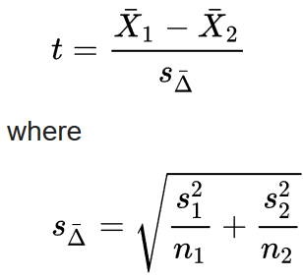
Types of t-test
An independent samples t-test compares the means for two groups.
A paired sample t-test compares means from the same group at different times (say, one year apart).
A one sample t-test tests the mean of a single group against a known mean.
Sources: https://www.statisticshowto.com/probability-and-statistics/t-test/ and Wikipedia

Slide 40
Wilcoxon rank test
The Wilcoxon test is a nonparametric statistical test that compares two paired groups, and comes in two versions, as given below:
the Rank Sum test or
the Signed Rank test.
The goal of the test is to determine if two or more sets of pairs are different from one another in a statistically significant manner
Basically you add the ranks of samples from one distribution, and check how likely they are to be high (or low) if they were from the combined distribution
Sources: https://www.investopedia.com/terms/w/wilcoxon-test.asp , https://www.stat.auckland.ac.nz/~wild/ChanceEnc/Ch10.wilcoxon.pdf

